Slide 1


[Top 5 category Analysis]

Slide 2


Today's agenda
Project recap
Problem
The Analytics team
Process
Insights
Summary

Slide 3

Social Buzz is fast growing technology unicorn that needs to adapt quickly to it’s global scale.
Accenture has begun a 3 months POC focusing on these tasks:
- Audit of big data practice
- Recommendations for a successful IPO
- An analysis of content categories that highlights the top 5 categories with the
largest aggregate popularity
Project Recap

Slide 4


Problem
Over 100,000 posts per day
36,500,000 contents per Year !
But How to capitalize on it when there is so much ?
Analysis To find Social buzz’s Top 5Most Popular Categories of Content

Slide 5



Andrew Fleming
(Chief Technical Architect)
The Analytics team
Marcus Rompton
(Senior Principle)
Abdulyekeen Mustapha Olawale
(Data Analyst)

Slide 6
Data Understanding
Process
1
2
Data Cleaning
3
Data Modeling
4
Data Analysis
5
Insights

Slide 7

Insights
Number of Unique Categories
16
Number of Reactions To the most Popular Category
1897
Month with Most Post
May

Slide 8
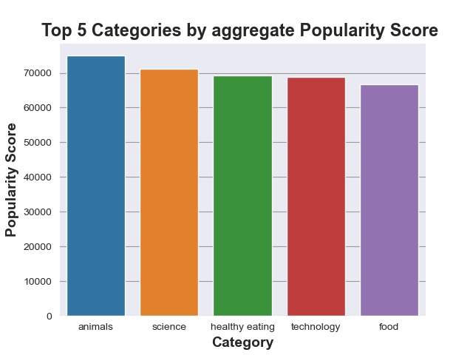

Slide 9
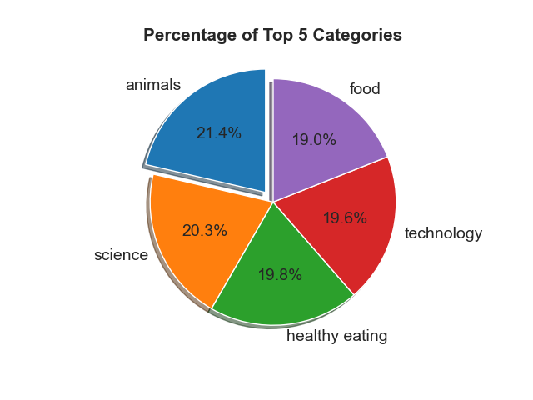

Slide 10

ANALYSIS
Animals and Science are the two most popular categories of content , showing that people enjoy “real-life” and “factual” content the most.
INSIGHT
Food is a common theme with top 5 categories with “Healthy Eating” ranking the highest. This may give an Indication to the audience within your user base. You could use this insight to create a campaing and work with healthy eating brands to boost user Engagement.
NEXT STEPS
This ad-hoc analysis is insightful, but it is time to take this analysis into large scale production for real time understanding of your business. we can show you how to do this .
Summary

Slide 11

Thank you!
ANY QUESTIONS?

